Slide 1

Exploring Image compression using Singular Value Decomposition (SVD)

Slide 2
1. Introduction
Image compression is the process of minimizing the amount of data needed to represent an image.
The storage and transmission of the images require memory space. By using image compression, we can reduce the storage space consumed by an image, so that the cost associated with the storage and transmission of the image can be minimized.

Slide 3
One approach to compress the image is by using SVD technique on the image matrix.
Singular Value Decomposition (SVD) is an effective tool for minimizing data storage and data transfer in the digital community.

Slide 4
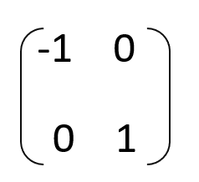
Mathematical preliminaries
Orthogonal Matrix:
A Square Matrix of order n x n is called orthogonal if its columns or rows are orthonormal vectors.
In other words, a square matrix A whose transpose is equal to its inverse i.e., AA^{l}=A^{l}A=I, is called as an orthogonal matrix.
Example:

Slide 5
Properties of Orthogonal Matrix: • The dot product of any two such column or row vectors is always zero and their length is 1 i.e. they are unit vectors.
• All of the vectors are orthogonal and independent to each other and hence they also form a basis for the respective vector space.
• The transpose of the orthogonal matrix is its inverse. Hence, QQT = QT Q = I and the inverse QT is also an orthogonal matrix.
• Determinant of an orthogonal matrix is always either 1 or -1.

Slide 6
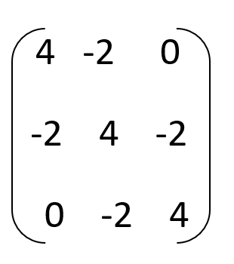
2)Positive definite matrix:
A positive definite matrix is a matrix in which all its eigenvalues are positive and is symmetric.
Example:

Slide 7
Properties of positive definite matrix:
• Scaling: If M is a positive definite and r > 0 is a real number then rM is a positive definite.
• Addition: If M and N are positive definite, then the sum M + N is also positive definite.
• Multiplication: If M and N are positive definite, then the products MNM and NMN are also positive definite. If MN = NM, then MN is also positive definite.

Slide 8
SVD
SVD is a linear matrix transformation that is used to compress images.
Singular Value Decomposition is a linear image matrix transformation in which an image matrix is decomposed into 3 matrices.
SVD represents an image matrix as the product of three matrices U, Σ, and V^{T}, where U and V are orthogonal matrices and Σ is a diagonal matrix.

Slide 9
Let A be any m × n matrix. SVD is the factorization of A into UΣV ^{T} , where U and V are orthonormal matrices.
Σ is a diagonal matrix comprised of the singular values of A.
The singular values σ1 > · · · > σn > 0 appear in descending order along the main diagonal of Σ. The numbers σ 2 1 ≥ · · · > σ 2 n are the eigenvalues of AA^{T} and A^{T} A.

Slide 10
SVD Algorithm
Step 1: Calculate AA^{T} and A^{T}A
Step 2: Calculating Eigenvalues and Σ
Find the Eigen values of AA^{T} and A^{T}A, using these eigen values we can compute singular values by taking the root. We can form Σ using this singular values.
Step 3: Finding U
Find the eigen vectors using the eigen values. The unit eigenvectors of AA^{T} are the columns of U.

Slide 11
Step 4: Finding V
The Unit eigen vectors of A^{T}A are the columns of V.
Step 5: The complete SVD
Now, we have U, Σ, and V^{T} . So, the SVD is complete.

Slide 12
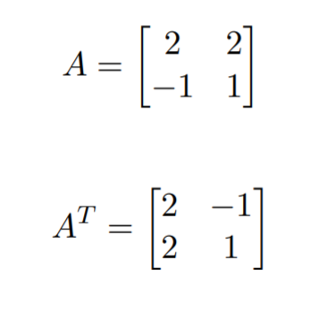
SVD Example
Consider the below 2 x 2 matrix A:
The Matrix and its transpose A^{T} will be,

Slide 13
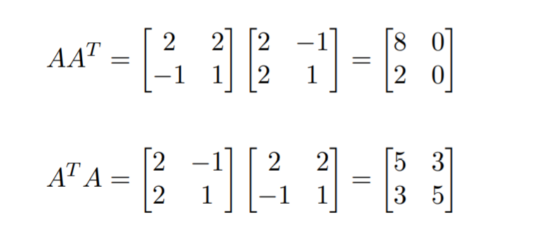
Calculating AA^{T} and A^{T} A.

Slide 14
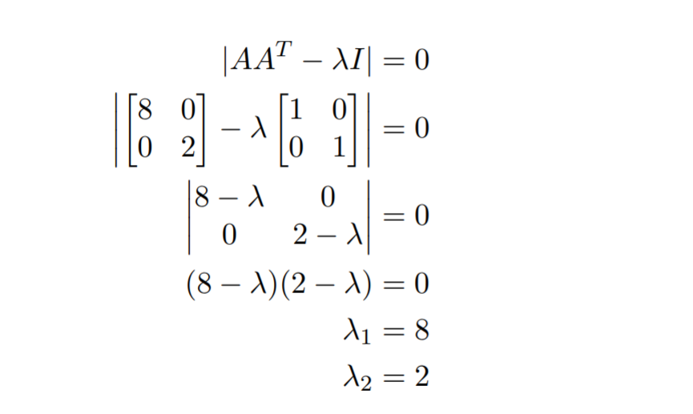
Finding Σ

Slide 15
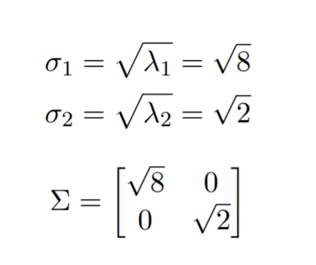

Slide 16
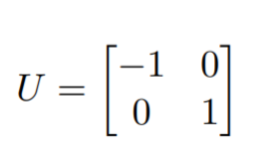
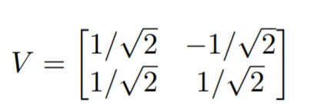
Calculating U and V
Using the equations,
(AA^{T} − λI)x = 0
(A ^{T} A − λI)x = 0. respectively

Slide 17
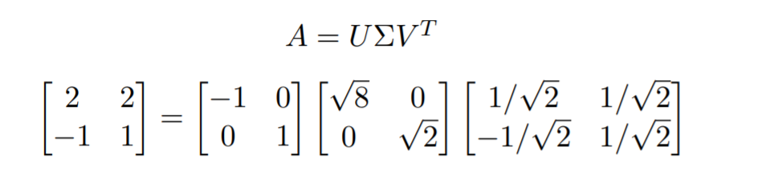
The Complete SVD
By securing U, Σ, and V the factorization of A is realized and the SVD is complete.
A = UΣV ^{T}

Slide 18
SVD in Image Compression

Slide 19
Why bother compressing image ?
Storing and Sharing high resolution images comes at a cost
Requires more storage
Requires more time for transmission
Consumes higher bandwidth
Modern day websites uses lot of images
Hence, without image compression, things will become very slow

Slide 20
How SVD helps in Image Compression
With SVD, we can reduce the sizes of image matrices by transforming the original matrices into UΣV^{T}
Then, using the rank of a matrix, we can remove redundant information
Which leads to us approximating the matrix by using fewer entries
In turn, we get images indistinguishable from their original images - only using a percentage of the original storage space

Slide 21
Main idea behind Image Compression using SVD
Apply SVD to images and then extracting "enough" information from the images to recreate images that are "close" to their originals.
Based on the level of detail that is needed in an image, we can choose to store more or less bytes in the compressed file

Slide 22
SVD in detail
Suppose we have a grayscale image of size 126 x 128
We can use a matrix to represent this image
Each component is represented by a 0-255
Write it as a 126X128 matrix A
Next, we can decompose A by SVD which gives us
A = UΣV^{T}
U is 126x126, Σ is 126X128, and V is 128x128 matrices
columns of U = eigenvectors of AA^{T}
diagonal entries of ∑= normalized singular values (√λ for A^{T}A)
columns of V = eigenvectors of A^{T}A
U and V are orthogonal matrices

Slide 23
SVD in detail
SVD, singular values = rank(A)
Furthermore, the matrix A can also be written as a sum of rank 1 matrices
A = σ₁u₁v₁^{T} + σ₂u₂v₂^{T} +…+ σ_{n}u_{n}v_{n}^{T}
each rank 1 matrix u_{k}v_{k}^{T} is the size of the original matrix. Each one of these matrices is a called a mode.
Since the singular values σ_{i} are ordered as σ₁ ≥ σ₂ ≥…≥ σ_{n} ≥ 0, significant compression of the image is possible if the spectrum of singular values has only a few very strong entries

Slide 24
SVD in detail
By eliminating small singular values, we can approximate A
We can therefore reconstruct the image from just a subset of modes

Slide 25
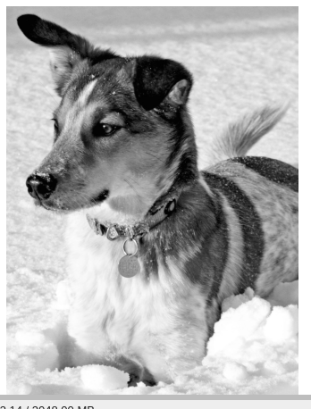
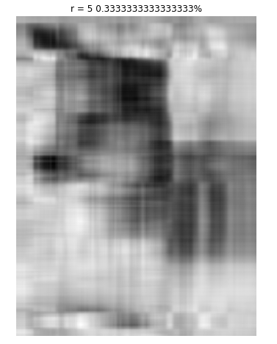
Demonstration
Original Image
first 5 diagonal entries

Slide 26
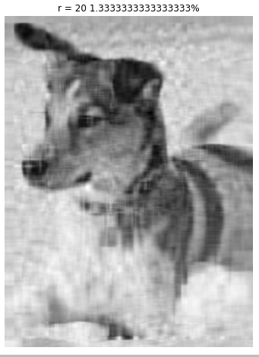
Demonstration
Original Image
first 20 diagonal entries

Slide 27
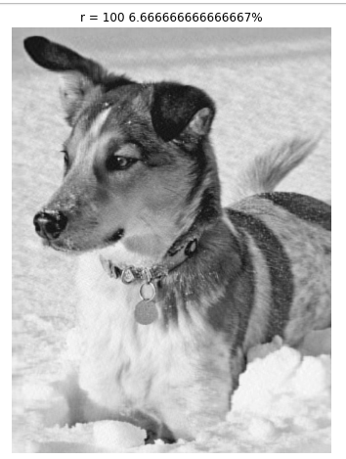
Demonstration
Original Image
first 100 diagonal entries

Slide 28
Application
Presented by Dablu Chauhan
Least Square problems
In real life, there might be times when we want to find a “best-fitting” curve to a set of some given points.
For example, people might want to find the relationship between the lean body mass of human bodies and their muscle strength or analyze how the housing price changes by years to obtain an estimation of the price in the future.[1]

Slide 29
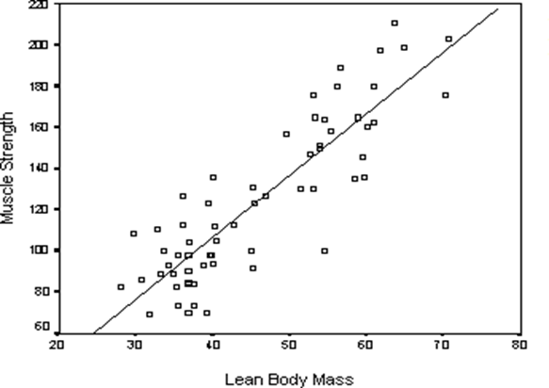
Least square solution of the relation between human lean body mass and muscle strength

Slide 30
2). Recommendation System
A recommender system is an intelligent system that predicts the rating and preferences of users on products. The major application of recommender systems is in suggesting related video or music for generating a playlist for the user when they are engaged with a related item
. Companies such as Amazon and Netflix collect tons of data, for example, users’ browsing or purchasing records and provide recommendation to them according to some analyses on the data.

Slide 31
User\movie | Matrix | Inseption | Martin | Titanic | War | Bahubali
Madhu | 1 | 1 | 1 | 0 | 0 | 2
Dablu | 3 | 3 | 3 | 1 | 0 | 1
Chandrakisor | 4 | 4 | 4 | 0 | 0 | 2
Rashmi | 5 | 5 | 5 | 1 | 2 | 0
Rohit | 0 | 0 | 0 | 4 | 3 | 5
Jyoti | 5 | 4 | 2 | 1 | 5 | 6
Aarohi | 0 | 0 | 0 | 2 | 2 | 1

Slide 32
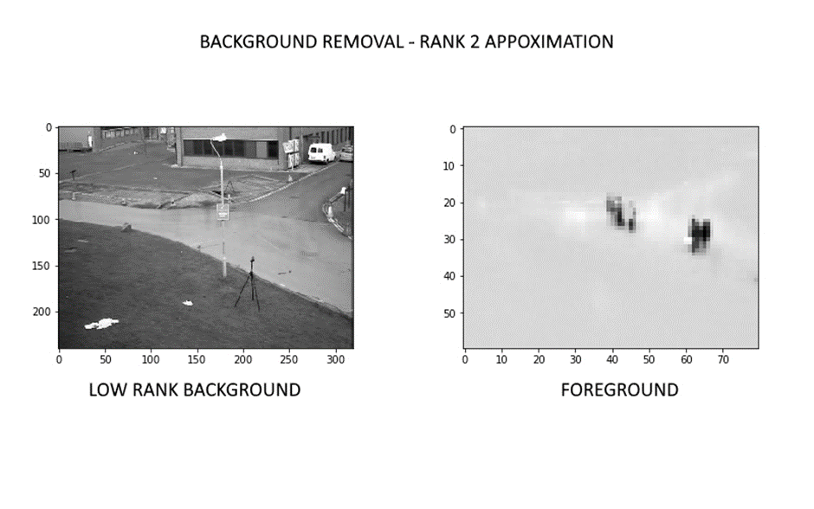
3) Removing Background from Videos[3]
Think of how you would distinguish the background of a video from its foreground. The background of a video is essentially static – it does not see a lot of movement. All the movement is seen in the foreground. This is the property that we exploit to separate the background from the foreground.

